Slide 1
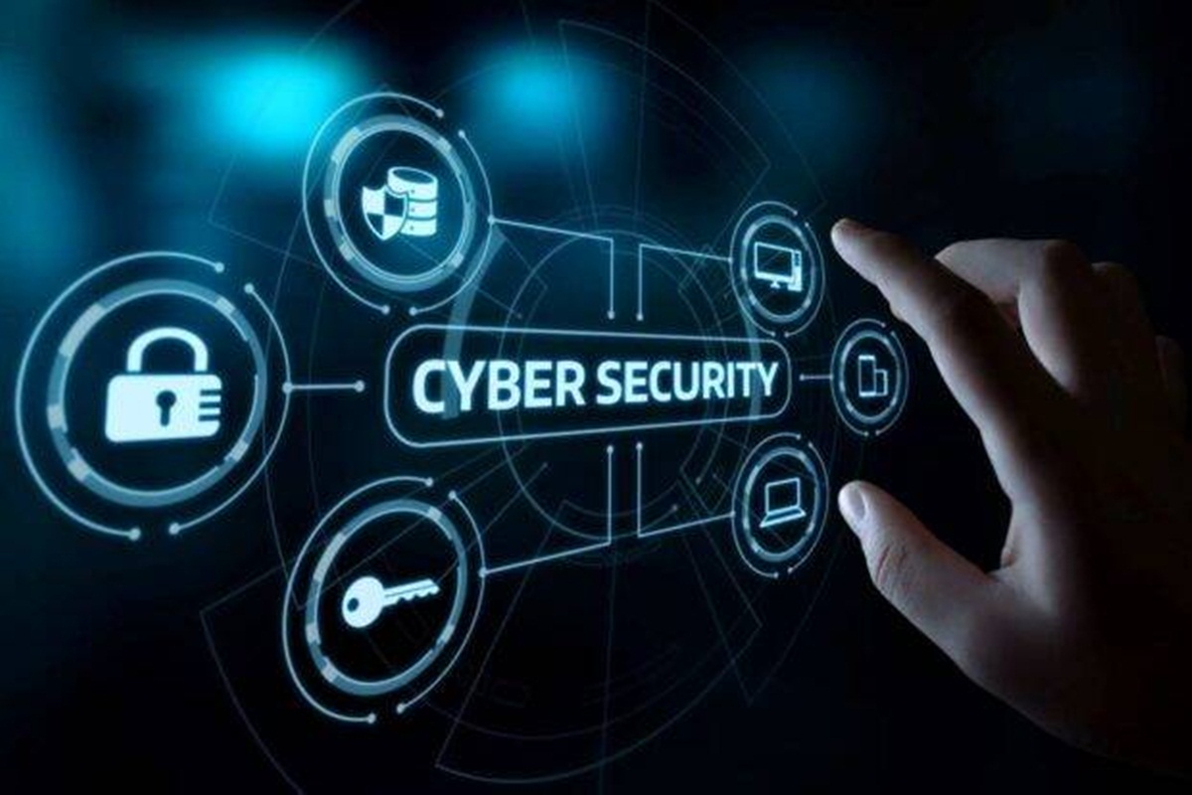
CYBER SECURITY
THREATS, METHODS, TOOLS.
Presented By: Shubhamkumar Yadav
Roll No: 25

Slide 2
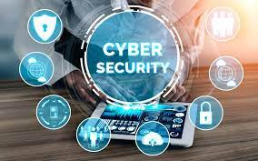
What is Cyber Security
Cyber security is the application of technologies, processes and controls to protect systems, networks, programs, devices and data from cyber attacks.

Slide 3
Cyber Threat
A cyber or cyber security threat is a malicious act that seeks to damage data, steal data, or disrupt digital life in general. Cyber threats include computer viruses, data breaches, Denial of Service (DoS) attacks, and other attack vectors.

Slide 4
Where Do Cyber Threats Come From?
Hostile Nation-States
Terrorist Groups
Corporate Spies and Organized Crime Organizations
Hacktivists
Disgruntled Insiders
Hackers
Accidental Actions of Authorized Users

Slide 5
Methods of Threats
Malware
Emotet
Denial of Service
Man in the Middle
Phishing
SQL Injection
Password Attacks

Slide 6
Malware
Malware is malicious software such as spyware, ransomware, viruses and worms. Malware is activated when a user clicks on a malicious link or attachment, which leads to installing dangerous software. Cisco reports that malware, once activated, can:
Block access to key network components (ransomware)
Install additional harmful software
Covertly obtain information by transmitting data from the hard drive (spyware)
Disrupt individual parts, making the system inoperable

Slide 7
Emotet
Emotet is “an advanced, modular banking Trojan that primarily functions as a downloader or dropper of other banking Trojans. Emotet continues to be among the most costly and destructive malware.”

Slide 8
Denial of Service
A Denial-of-Service (DoS) attack is an attack meant to shut down a machine or network, making it inaccessible to its intended users. DoS attacks accomplish this by flooding the target with traffic, or sending it information that triggers a crash.

Slide 9
Man in the Middle
A man-in-the-middle (MITM) attack occurs when hackers insert themselves into a two-party transaction. After interrupting the traffic, they can filter and steal data, according to Cisco. MITM attacks often occur when a visitor uses an unsecured public Wi-Fi network. Attackers insert themselves between the visitor and the network, and then use malware to install software and use data maliciously.

Slide 10
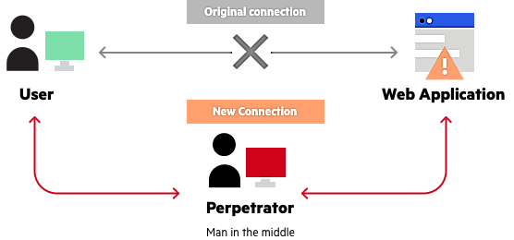

Slide 11
Phishing
Phishing attacks use fake communication, such as an email, to trick the receiver into opening it and carrying out the instructions inside, such as providing a credit card number. “The goal is to steal sensitive data like credit card and login information or to install malware on the victim’s machine,”

Slide 12
SQL Injection
A Structured Query Language (SQL) injection is a type of cyber attack that results from inserting malicious code into a server that uses SQL. When infected, the server releases information. Submitting the malicious code can be as simple as entering it into a vulnerable website search box

Slide 13
Password Attacks
A password attack refers to any of the various methods used to maliciously authenticate into password-protected accounts. These attacks are typically facilitated through the use of software that expedites cracking or guessing passwords.

Slide 14
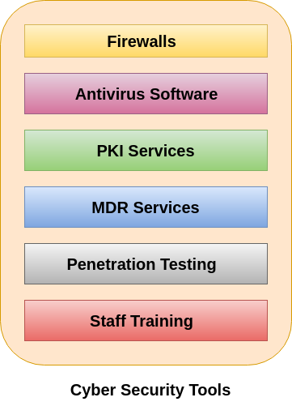
Cyber Security Tools
There are many different aspects of the cyber defence may need to be considered. Here are six essential tools and services that every organization needs to consider to ensure their cybersecurity is as strong as possible.

Slide 15
Firewalls
A Firewall is a network security device that monitors and filters incoming and outgoing network traffic based on an organization's previously established security policies. At its most basic, a firewall is essentially the barrier that sits between a private internal network and the public Internet.

Slide 16
Antivirus Software
Antivirus is a kind of software used to prevent, scan, detect and delete viruses from a computer. Once installed, most antivirus software runs automatically in the background to provide real-time protection against virus attacks.

Slide 17
PKI Services
PKI stands for Public Key Infrastructure. This tool supports the distribution and identification of public encryption keys. It enables users and computer systems to securely exchange data over the internet and verify the identity of the other party. People associate PKI with SSL or TLS. It is the technology which encrypts the server communication and is responsible for HTTPS and padlock that we can see in our browser address bar

Slide 18
Managed Detection and Response Service (MDR)
MDR is an advanced security service that provides threat hunting, threat intelligence, security monitoring, incident analysis, and incident response. It is a service that arises from the need for organizations (who has a lack of resources) to be more aware of risks and improve their ability to detect and respond to threats. MDR also uses Artificial Intelligence and machine learning to investigate, auto detect threats, and orchestrate response for faster result.

Slide 19
Penetration Testing
Penetration testing is also known as pen testing or ethical hacking. It describes the intentional launching of simulated cyberattacks that seek out exploitable vulnerabilities in computer systems, networks, websites, and applications.

Slide 20
Staff Training
Staff training is not a 'cybersecurity tool' but ultimately, having knowledgeable employees who understand the cybersecurity which is one of the strongest forms of defence against cyber-attacks. Every business can organize these training tools to educate their employee who can understand their role in cyber security.

Slide 21
References:-
https://www.google.com/
https://www.imperva.com/
https://www.javatpoint.com/
https://www.comptia.org/
https://www.upguard.com/
https://support.microsoft.com/
https://www.cisecurity.org/

Slide 22
Thank You

